Slide 1
Pharmacokinetic Studies

Slide 2
Pharmacokinetic Studies
Strength of drug response and toxicity are a function of drug concentration at the target site
Drug cannot be placed directly at target site
Must be absorbed and then moved
Simultaneous distribution to tissues/organs
Metabolized and eliminated
Concentration at site of action often can’t be measured directly
Concentration can be measured in blood/plasma

Slide 3
Pharmacokinetics (PK)
PK: What the body does with the drug
Understanding of concentration in plasma
Concentration in plasma associated with concentration at site of action
Need to understand mechanisms of ADME:
Absorption
Distribution
Metabolism
Elimination
ADME mechanisms impact the kinetics of drug throughout the body
Notes:
Wanting to find the therapeutic level.

Slide 4
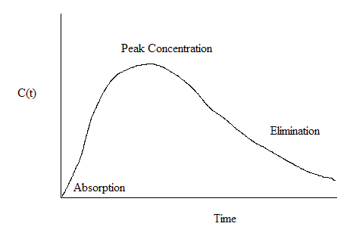
Concentration vs. Time

Slide 5

Optimal Administration of Drugs
Assessment of relationship between drug concentration and patient outcomes
Too low $⇒$ ineffective treatment
Too high $⇒$ toxicity
Therapeutic window: Targeted concentration range to produce optimal patient outcomes
Want to maximize duration that concentration lies within therapeutic window

Slide 6
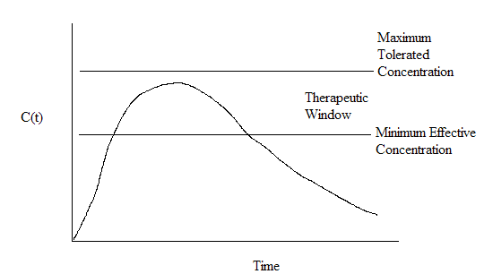
Therapeutic Window

Slide 7
Dosage regimens
What dose/schedule appropriately targets the therapeutic window?
Loading dose:
Used to elevate concentration within window quickly
How much?
Maintenance dose:
Smaller doses used to maintain concentration within window as existing drug is eliminated
What frequency, how much?
Intravenous vs. oral doses
Notes:
Intravenous = injection
Maintenance dose seeks to keep patient within the therapeutic window for a longer duration.

Slide 8
Pharmacokinetics
PK study design
Collect blood samples to measure concentration as a function of time
PK models
Mathematical model for ADME which describe concentration as a function of time/dose
Nonlinear models described by differential equation of changes in concentration over time
Single compartment vs. multi-compartment models

Slide 9

Outcomes of Interest
Absorption rate
Elimination rate
Area under the time-concentration curve (AUC)
Peak concentration ($C_{max}$)
Trough concentration ($C_{min}$): Minimum concentration before next dose administration
Half life ($t_{0.5}$)
Correlation between concentration measures and
Toxicity
Efficacy
Notes:
A lot of this is observable on the graphs

Slide 10
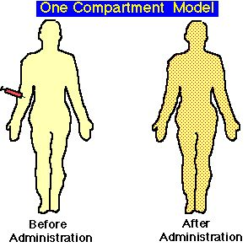
Single Compartment Model
Drug given is rapidly distributed to extra-vascular tissues
Uniform distribution across tissues/organs
Kinetics depend on method of administration:
IV bolus (all at once)
IV continuous infusion
Oral

Slide 11


Single Compartment Model: IV Bolus
Model assumes rate of elimination $kel$ is constant
Differential equation of drug concentration:
$$\frac{dC}{dt}=−kel∙C\left(t\right)$$
$C\left(t\right)=C\left(0\right)e^{−kel∙t}$
$\log{C\left(t\right)}=\log{C\left(0\right)}−kel∙t$ (linear in $t$)
Notes:
Kel = rate of elimination
Final line is a LINE, a linear function.

Slide 12
Single Compartment Model: IV Bolus
Example Data: Fit using linear regression
Time (hr) | 1 | 2 | 3 | 4 | 6 | 8 | 10
C (mcg/ml) | 72 | 51 | 33 | 20 | 14 | 9 | 4
Notes:
Concentration dropping over time. Prof thinks exponential decay.

Slide 13
Model Fitting in SAS
data a; input t c; cards;
1 72
2 51
3 33
4 20
6 14
8 9
10 4
; run;
data a; set a; logc=log(c); run;
proc reg data=a;
model logc = t;
run;
Parameter Estimates
Parameter Standard
Variable DF Estimate Error t Value Pr > |t|
Intercept 1 4.46734 0.10784 41.43 <.0001
t 1 -0.30436 0.01881 -16.18 <.0001
Notes:
Proc reg = linear regression model

Slide 14

Fitted Model
Starting Concentration: $C\left(0\right)= e^{4.467}=87.095 mcg/ml$
Rate of elimination: $kel=0.304/hr$
Other parameters:
Area under the concentration curve (AUC)
$AUC= \int{C\left(t\right)dt}=\frac{C(0)}{kel}=286.497 mcg∙hr/ml$
Half life ($t_{0.5}$): Time until half of drug concentration is eliminated
$t_{0.5}=\frac{\log{2}}{kel}=2.280 hr$
Notes:
Rate of Elimincation: kel = slope

Slide 15
Fitted Model

Slide 16
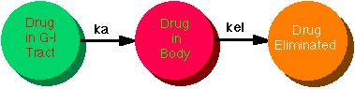

Oral Administration
Rate of absorption from GI tract: $ka$
Rate of elimination from body: $kel$
Both rates assumed to be constant
Notes:
Two rates to consider here.

Slide 17

Oral Administration
Differential Equation for drug concentration after single dose of drug:
$\frac{dC}{dt}=ka∙C_{a}\left(t\right)−kel∙C\left(t\right)$, implying
$C\left(t\right)=\frac{D∙ka∙kel}{Cl∙(ka−kel)}\left[e^{−kel∙t}−e^{−ka∙t}\right],$ where
D = drug dose,
Cl = the clearance of the drug from the system
(volume of plasma cleared of drug per unit time)

Slide 18
Nonlinear Model Fitting: Example
Patient given oral dose of drug theophylline; concentrations measured at multiple times over a 25 hour period

Slide 19
Nonlinear Model Fitting by SAS PROC NLMIXED
proc nlmixed data=a;
parms beta1=-3.22 beta2=0.47
beta3=-2.45 s2=0.5;
cl=exp(beta1);
ka=exp(beta2);
ke=exp(beta3);
pred=dose*ke*ka*(exp(-ke*time)
-exp(-ka*time))/cl/(ka-ke);
model conc ~ normal(pred,s2);
run;
data a;
input time conc dose;
cards;
0 0.74 4.02
0.25 2.84 4.02
0.57 6.57 4.02
1.12 10.5 4.02
2.02 9.66 4.02
3.82 8.58 4.02
5.1 8.36 4.02
7.03 7.47 4.02
9.05 6.89 4.02
12.12 5.94 4.02
24.37 3.28 4.02
;
run;
Notes:
Beta estimates not from the data.

Slide 20
Nonlinear Model Fitting: Results
The NLMIXED Procedure
Parameter Estimates
Standard
Parameter Estimate Error DF t Value Pr > |t| Alpha
beta1 -3.9159 0.1090 11 -35.93 <.0001 0.05
beta2 0.5752 0.1294 11 4.44 0.0010 0.05
beta3 -2.9196 0.1443 11 -20.24 <.0001 0.05
s2 0.3896 0.1661 11 2.35 0.0388 0.05
Parameter Estimates
Parameter Lower Upper Gradient
beta1 -4.1557 -3.6760 -0.00082
beta2 0.2904 0.8600 0.00024
beta3 -3.2371 -2.6021 0.00079
s2 0.02396 0.7553 -0.00007

Slide 21
Fitted model

Slide 22

Nonlinear Model Fitting
Absorption rate: $ka=e^{0.575}=1.777/hr$
Elimination rate: $kel=e^{−2.920}=0.054/hr$
Clearance: $cl=e^{−3.916}=0.020 ml/hr$
Area under the curve (AUC):
$AUC=\frac{D}{Cl}=\frac{4.02}{e^{−3.916}}=201.801 mg∙hr/ml$

Slide 23
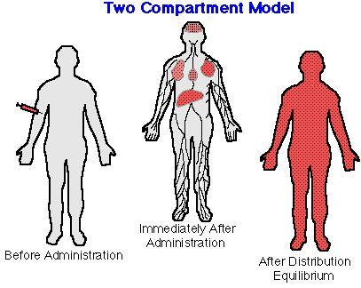
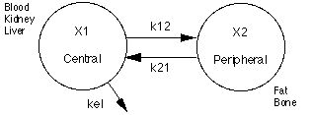
Multi-compartment Model
Body is not a well-mixed container
Drug distributed b/w one or more compartments
More complicated differential equations
See Piantadosi 16.2 for
details on modeling

Slide 24
More Complex PK Models
Rates of absorption or elimination may not be constant over time
Nonlinear differential equations involved; may need numerical methods to solve
Commercial software (ex: WinNonLin) is standard for this analysis

Slide 25

Non-compartmental Methods
Requires fewer assumptions than compartmental models
Direct analysis of parameters for each individual:
Define $M_{r}=\int_{0}^{∞}{t^{r}C\left(t\right)dt}$
$AUC = M_{0}=\int_{0}^{∞}{C\left(t\right)dt}$
Area under moment curve: $AUMC = M_{1}=\int_{0}^{∞}{t∙C\left(t\right)dt}$
Mean residence time: Average time drug stays in body
$MRT=\frac{M_{1}}{M_{0}}$
Integrals are approximated by numerical methods using patient’s data
Ex: Trapezoid rule, Simpson’s rule

Slide 26




Example
AUC Calculation
AUMC Determination
Time (hr) C (mg/L)
0 2.55
1 2.00
3 1.13
5 0.70
7 0.43
10 0.20
18 0.025
Area (mg$∙$hr/L)
-
2.275
3.13
1.83
1.13
0.945
0.900
Total 10.21
C x t (mg/L$∙$hr)
0
2.00
3.39
3.50
3.01
2.00
0.45
Area (mg$∙$hr²/L)
-
1.00
5.39
6.89
6.51
7.52
9.80
37.11
Over the time frame 0 – 18 hours, estimates are:
$$AUC=10.21 mg∙\frac{hr}{L}, AUMC=37.11 mg∙\frac{{hr}^{2}}{L},$$
$MRT=\frac{AUMC}{AUC}=3.63 hr$

Slide 27
Analysis of Pharmacokinetic Data
PK studies collect data from multiple subjects, so there may be interest in both:
PK parameters of each subject
Population- averaged PK parameters across subjects
PK parameters may be correlated with efficacy outcomes; how to assess this?
Two strategies:
Fit separate dose-concentration curves for each patient
Combined analysis of all patients using nonlinear mixed effects model

Slide 28
Multi-subject PK Example 1
Study of treatment for graft-versus-host disease after BMT in 32 patients
Efficacy outcomes: Treatment response at day 28 and 56
Response defined as either complete or partial resolution of symptoms, i.e. overall response
PK parameters were estimated separately for each subject and then compared between responders and non-responders

Slide 29
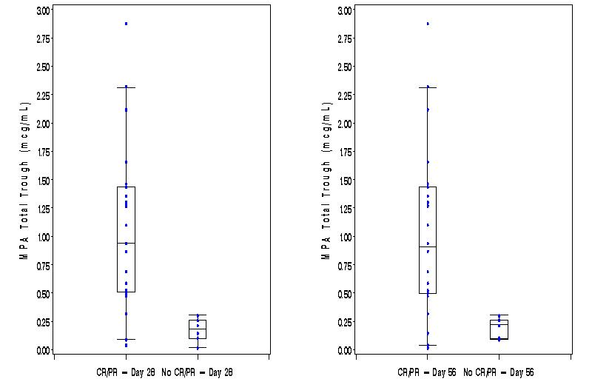
Multi-subject PK Example 1

Slide 30
Multi-subject PK Example 2
Estimation of PK parameters in one-compartment model after oral administration of drug theophylline
12 subjects measured over a 25 hour time period
Earlier example analyzed subject 1 alone

Slide 31

Nonlinear Mixed Model
Subject-specific effects for model parameters:
$$C_{i}\left(t\right)=\frac{D_{i}∙{ka}_{i}∙kel}{{Cl}_{i}∙({ka}_{i}−kel)}\left[e^{−kel∙t}−e^{−{ka}_{i}∙t}\right]+ε_{it,}$$
${Cl}_{i}=e^{β_{1}+b_{i1}},$
${ka}_{i}=e^{β_{2}+b_{i2}},$
$kel=e^{β_{3}},$
${(b_{i1},b}_{i2}) \sim iid Normal\left(0,Σ\right),$
$ε_{it}\sim iid Normal(0,σ_{e}^{2})$
Notes:
Ka is absorption rate
Kel is elimination rate
.b’s are the subject specific events
Epsilon are errors

Slide 32
Nonlinear Mixed Model Fitting by SAS PROC NLMIXED
data a;
input subject time conc dose;
cards;
1 0 0.74 4.02
1 0.25 2.84 4.02
1 0.57 6.57 4.02
1 1.12 10.5 4.02
1 2.02 9.66 4.02
1 3.82 8.58 4.02
1 5.1 8.36 4.02
1 7.03 7.47 4.02
1 9.05 6.89 4.02
1 12.12 5.94 4.02
1 24.37 3.28 4.02
2 0 0 4.4
(other data lines found in SAS online documentation of proc nlmixed, Example 61.1); run;
proc nlmixed data=a;
parms beta1=-3.22
beta2=0.47 beta3=-2.45
s2b1=0.03 cb12=0 s2b2=0.4
s2=0.5;
cl=exp(beta1+b1);
ka=exp(beta2+b2);
ke=exp(beta3);
pred=dose*ke*ka*
(exp(ke*time)-exp(ka*time))
/cl/(ka-ke);
model conc~normal(pred,s2);
random b1 b2~normal([0,0],
[s2b1,cb12,s2b2])
subject=subject;
run;

Slide 33
Nonlinear Mixed Model: Results
Parameter Estimates
Standard
Parameter Estimate Error DF t Value Pr > |t| Alpha Lower
beta1 -3.2268 0.05950 10 -54.23 <.0001 0.05 -3.3594
beta2 0.4806 0.1989 10 2.42 0.0363 0.05 0.03745
beta3 -2.4592 0.05126 10 -47.97 <.0001 0.05 -2.5734
s2b1 0.02803 0.01221 10 2.30 0.0445 0.05 0.000833
cb12 -0.00127 0.03404 10 -0.04 0.9710 0.05 -0.07712
s2b2 0.4331 0.2005 10 2.16 0.0560 0.05 -0.01353
s2 0.5016 0.06837 10 7.34 <.0001 0.05 0.3493
Parameter Estimates
Parameter Upper Gradient
beta1 -3.0942 -0.00009
beta2 0.9238 3.645E-7
beta3 -2.3449 0.000039
s2b1 0.05523 -0.00014
cb12 0.07458 -0.00007
s2b2 0.8798 -6.98E-6
s2 0.6540 6.133E-6

Slide 34
Fitted curves

